Slide 1
Capstone Project: Oral and PowerPoint Presentation
Jeffrey Wolff
Colorado State University Global
22FD-MIS581-1: Capstone Course
Dr. Lisa Bryan
December 4, 2022
Notes:
This is a presentation of the capstone research project conducted using historical financial and economic data on changes in Fed Funds rate and how it effects the average consumer with respect to economic conditions and if the data can be used to make any predictions in the future that the consumer can use for economic planning.

Slide 2
Examining Fed Monetary Policy on the Economy and its Impact to the Consumer
The Fed influences monetary policy by changing the Fed Funds Interest Rate (FFR).
Changes in FFR influence the rate all lenders use for interest rates.
As interest rates change the amount of lending changes, bond prices change, and investment in the economy goes up or down as the money supply increase or decrease.
The Fed makes more aggressive changes in FFR during times of extreme economic conditions
Money Supply easing or tightening by purchasing or selling treasuries.
Called Quantitative Easing/Tightening.
Recently the Fed has also engaged in buying other asset types.
US government has engaged in direct stimulus to businesses and individuals.
The effects of Fed policy on the economy have been well documented, but less obvious are direct effects to the individual consumer.
A relationship established between Fed action and how the economy will impact the consumer would be a great tool for consumer to plan for economic changes.
Notes:
The Fed influences monetary policy by changing the Fed Funds Interest Rate (FFR). Changes in FFR influence the rate all US banks and other lenders use for interest rates (Ireland, 2019).
As interest rates change the amount of lending changes, bond prices change, and investment in the economy goes up or down as the money supply increase or decrease (Ireland, 2019).
The Fed makes more aggressive changes in FFR during times of extreme economic conditions and engages in money supply easing or tightening by purchasing or selling treasuries. This is called Quantitative Easing and Tightening (Reis, 2009).
Recently the Fed has also engaged in buying assets and the US government has engaged in direct stimulus to businesses and individuals (Goodfriend, 2014).
The effects on the economy in general have been well documented, but it is less obvious what the individual consumer can do with the information the media reports about the Fed and the economy (Filardo et al., 2022).
If a relationship could be established between Fed action and how the economy will change to impact the consumer, this could be a great tool to be used by financial planners and the consumer to plan for economic changes.

Slide 3
Research Question, Theory, and Hypotheses
Question: How do changes in FFR affect inflation, prices, stock performance, and unemployment for the average consumer and can those Fed funds rate changes be used to predict when and by how much prices, inflation, stock performance and unemployment will be affected?
Theory: Changes in FFR correlate to changes in inflation, unemployment, consumer prices, stock performance and housing prices and can be used to predict when and by how much those items will change.
General Null and Alternative Hypothesis Set:
H₀: There is no effect on economic conditions caused by changes in monetary policy through the Fed changing interest rates.
H_{a}: There is an effect on economic conditions caused by changes in monetary policy through the Fed changing interest rates.
Notes:
Using the data from public sources, this study examines the relationship between FFR and the 5 economic conditions that may be affected by changes in FFR made by the Fed.
This poses the research question: How do changes in FFR affect inflation, prices, stock performance, and unemployment for the average consumer and can those Fed funds rate changes be used to predict when and by how much prices, inflation, stock performance and unemployment will be affected?
The theory to be postulated is: Changes in FFR correlate to changes in inflation, unemployment, consumer prices, stock performance and housing prices and can be used to predict when and by how much those items will change.
From this, the General Null and Alternative Hypothesis is formulated to be:
H₀: (the null hypothesis) There is no effect on economic conditions caused by changes in monetary policy through the Fed changing interest rates.
and
H_{a}: (the alternative hypothesis) There is an effect on economic conditions caused by changes in monetary policy through the Fed changing interest rates.

Slide 4
5 Sub-Set Hypotheses for each Economic Condition Variable:
H1_{o}: There is no effect on unemployment rate caused by changes in monetary policy through the Fed changing interest rates.
H1_{a}: There is an effect on unemployment rate caused by changes in monetary policy through the Fed changing interest rates.
H2_{o}: There is no effect on inflation rate caused by changes in monetary policy through the Fed changing interest rates.
H2_{a}: There is an effect on inflation rate caused by changes in monetary policy through the Fed changing interest rates.
H3_{o}: There is no effect on stock market performance (adjusted for inflation) caused by changes in monetary policy through the Fed changing interest rates.
H3_{a}: There is an effect on stock market performance (adjusted for inflation) caused by changes in monetary policy through the Fed changing interest rates.
H4_{o}: There is no effect on average home prices (adjusted for inflation) caused by changes in monetary policy through the Fed changing interest rates.
H4_{a}: There is an effect on average home prices (adjusted for inflation) caused by changes in monetary policy through the Fed changing interest rates.
H5_{o}: There is no effect on the consumer price index caused by changes in monetary policy through the Fed changing interest rates.
H5_{a}: There is an effect on the consumer price index caused by changes in monetary policy through the Fed changing interest rates.
Notes:
The general hypothesis is not complex but because the study will be looking at the effect on each of 5 variables, it makes sense to use break the general set of hypotheses into 5 subsets, one for each outcome variable, using the Hierarchy of Hypotheses (HoH) method presented by Heger (2021). The 5 pairs of null and alternative hypotheses each cover one of the variables.
The H1 pair is for unemployment
The H2 pair is for inflation
The H3 pair is for stock market performance
The H4 pair is for home prices
And The H5 pair for the consumer price index (CPI).

Slide 5
Literature Review
Much has been researched about Fed Policy, interest rates and how Fed Policy affects monetary policy and the financial sector.
Additional research has reviewed the effects of Quantitative Easing (QE) and stimulus legislation on the economy.
After the 2008 Credit Crisis and after COVID
Lasting impact the short-term emergency policies had on the economy for years after the initial actions.
There has been many studies on the relationship of interest rates on bond prices.
One study characterized QE and stimulus as indirect controls on long-term interest rates.
Some research deemed any manipulation by the Fed as an exacerbation of economic problems.
Tend to prolong and deepen downturns.
Any actions destabilize the natural economic cycle.
These arguments speak to the effectiveness of Fed monetary policy, but do not answer the question how consumers should react to those actions.
There have been several studies researching the correlation between interest rates, inflation, stock performance, prices.
There has been a theory that short-term rates led to changes in Fed forecast for rate changes because the Fed responds to expected inflation.
Impact long-term rates.
Long-term rates are connected to short term rates on the yield curve through bond prices.
This creates a feed-back loop of sorts.
A similar circular correlation was studied in the relationship between FFR and the CPI.
Additional studies of economic inputs and outputs show correlation but typically causation was in the opposite direction of the data proposed to be studied in this research.
Taken together, studies of circular correlations between interest rates and both inflation and price changes may mean changes FFR could predict changes in inflation and pricing even without causation.
Notes:
Much has been researched about Fed Policy, interest rates and how Fed Policy affects monetary policy and the financial sector. Additional research has reviewed the effects of Quantitative Easing (QE) and stimulus legislation on the economy after the 2008 Credit Crisis and after COVID as well as the lasting impact the short-term, emergency stabilization- focused policies had on the economy for years after the initial actions (Ireland, 2019 and Filardo et al., 2022). There has been many studies on the relationship of interest rates on bond prices, which impact inflation and there has been characterizations of QE and stimulus as indirect controls on long-term interest rates and, therefore, impact bonds and inflation (Canova et al., 2011).
Some research deemed any manipulation by the Fed as an exacerbation of economic problems that tend to prolong and deepen downturns. Therefore, any action might be considered bad, and any actions disrupt the natural cycles of the economy (Goodfriend, 2014 and Filardo et al. 2022). While these arguments speak to the effectiveness of Fed monetary policy, it does not answer the question how consumers should react to those actions, for which they have no control.
There have been several studies researching the correlation between interest rates, inflation, stock performance, prices going back many years (Gibson, 1972 and Titman & Warga, 1989).
There has been a theory that short-term rates led to forecasted Fed funds target rate changes because the Fed responds to expected inflation, which impact long-term rates. Long-term rates are connected to short term rates on the yield curve through bond prices. This creates a feed-back loop of sorts (Cochrane & Piazzesi, 2002).
A similar cycle was studied in the relationship between FFR and the CPI. It was thought the FFR might cause changes in the CPI inflation rate, but it was ultimately found that the FFR was a reaction by the Fed to CPI and PPI changes (Bierens, 2000). Additional studies of economic inputs and outputs show correlation but typically causation was in the opposite direction of the data proposed to be studied in this research.
Taken together, these studies of correlations between interest rates and both inflation and price changes along with their circular nature may mean changes FFR could predict changes in inflation and pricing even without causation.

Slide 6
Methodology
Use Quantitative Data to test the hypothesis and measure the relationship between changes in monetary policy and changes in economic conditions.
Data gathered from public sources
Federal Reserve
Bureau of Labor Statistics
Datahub website
National Association of Realtors
Robert Shiller home prices
Federal Housing Finance Agency
Combined into one dataset using Excel with data records matched by month
1- 3- and 6- month change variables derived from raw data
Correlation used to compare FFR with each outcome variables at all time combinations
Regression used to analyze most significant combinations
Notes:
The methodology for the research uses quantitative data to test the hypothesis and measure the relationship between changes in monetary policy and changes in economic conditions.
The data was gathered from public sources including the Federal Reserve, Bureau of Labor Statistics, the datahub website, and dqydj.com which compiled housing data from the National Association of Realtors, Robert Shiller home prices, and the Federal Housing Finance Agency (Federal Reserve of St. Louis, 2016, Bureau of Labor Statistics, 2016, US Department of Labor, 2022, Kariv & Pollock, 2022, and PK, 2022).
The 4 data sources were combined into one dataset using Excel with data records matched by month. The 1- 3- and 6- month change variables were derived from raw data and aligned by month so that the outcomes for 1, 3, and 6 months later matched to the current record’s month.
Pearson correlation tests were used to compare FFR with each outcome variables at all time combinations. The most significant pairs were then analyzed with linear regression to find a predictive model for quantifying change in the economic outcome variables.

Slide 7
Methods
Compare change in FFR, representing monetary policy, to each of the 5 dependent economic variables: inflation, unemployment, CPI, stock market performance, and home prices.
Using SAS Studio, the data will be analyzed with the Pearson correlation test.
All 3 time periods of FFR change will be compared to all 3 time periods of change in each economic variable.
All correlations with a P-value less than 5% (.05) are considered significant and evidence of correlation.
If a pair of variables have a significant correlation, the timeframe pair with the strongest correlation coefficient will represent that pair.
Those with P-values over (0.5) will be considered insignificant correlation and support the null hypothesis for that variable.
The pairs that are significant and strongest are graphed to show how they are correlated and provide evidence of when and in what direction changes in FFR will impact the consumer.
SAS Studio will be used to create a predictive model, using simple linear regression, for each significant pair.
If the results of the regression model have a high enough R² value, then they can be used to potentially predict amount of change in that economic factor.
Notes:
To test the 5 sub-set hypotheses, change in FFR, representing monetary policy, was compared to each of the 5 dependent economic variables: inflation, unemployment, CPI, stock market performance, and home prices.
Using SAS Studio, the data will be analyzed with the Pearson correlation test (Wang & Mi, 2019).
All 3 time periods of FFR change will be compared to all 3 time periods of change in each economic variable.
All correlations with a P-value less than 5% (.05) are considered significant and evidence of correlation.
If a pair of variables have a significant correlation, the timeframe pair with the strongest correlation coefficient will represent that pair.
Those with P-values over (0.5) will be considered insignificant correlation and support the null hypothesis for that variable.
The pairs that are significant and strongest are graphed to show how they are correlated and provide evidence of when and in what direction changes in FFR will impact the consumer.
SAS Studio will be used to create a predictive model, using simple linear regression, for each significant pair (Wang & Mi, 2019).
If the results of the regression model have a high enough R² value, then they can be used to potentially predict amount of change in that economic factor.

Slide 8
Limitations
There is no data that represents change in money supply (Quantitative Easing and Tightening).
Besides interest rate changes, changes in money supply and stimulus are tools used in extreme economic conditions.
It is very difficult to measure this kind of data.
There is no data available for some variables after 2016.
Results for the COVID era would be helpful.
Another group of datapoints during a relatively extreme economic period generally would be helpful.
National data may mask regional effects, particularly in unemployment, CPI, and housing prices –more granularity might be helpful.
Notes:
Some limitations to the research include the following:
First, there is no data that represents change in money supply by Fed action such as Quantitative Easing and Tightening. Besides interest rate changes, changes in money supply and stimulus are tools used in extreme economic conditions and may have significant impact on the outcome variables. However, it is very difficult to measure this kind of data and is beyond the scope and timeframe available.
Second, there is no data available for some variables after 2016. Results for the COVID era would be helpful and another group of datapoints during a relatively extreme economic period generally would be helpful
Third, national data may mask regional effects, particularly in unemployment, CPI, and housing prices. More granularity might be helpful.

Slide 9
Ethical Considerations
Protecting personal privacy and integrity of the data is very important.
This data is from public records and national averages so no privacy concerns.
Integrity is maintained by using consistent time periods when combining data sources.
All derived data uses the same methods of transformation to retain consistent measures.
Housing and Stock Market data are adjusted for inflation and converted to percent change to have consistent comparisons with other variables.
Adjusting for inflation eliminates covariance with the inflation variable.
Notes:
Protecting personal privacy and maintaining integrity of the data are 2 very important ethical considerations for this research (Shaw & Satalkar, 2018).
Fortunately, this data is from public records and national averages so there are no material privacy concerns.
Data integrity is maintained by using consistent time periods when combining data sources
All derived data uses the same methods of transformation to retain consistent measures.
Housing and stock market data are adjusted for inflation and converted to percentage change to have consistent comparisons with other variables
Adjusting for inflation eliminates covariance with the inflation variable.

Slide 10
Findings
Change in FFR correlation was found to be significant for unemployment, inflation and CPI for at least one timeframe pair. (See Tables 1a, 1b, and 1e)
Change in FFR was not significantly correlated to changes in the S&P 500 or home prices when adjusted for inflation. (See Tables 1c and 1d)
The null hypothesis for H₁ (Unemployment), H₂ (Inflation), and H₅ (CPI) were not supported and favored the alternative hypotheses that change in FFR has an effect on these 3 variables.
The null hypothesis for H₃ (Stock Performance) and H₄ (Home Prices) were supported. There is no evidence FFR correlates with these variables.
The data supports that a 6 month change in FFR has the most correlation with changes in inflation and CPI 6 months later. (See Figure 1a and 1b)
The data supports that a 3 month change in FFR has the most correlation with changes in unemployment 3 months later. (See Figure 1c)
The linear regression models for these 3 variables do not provide evidence of a quantifiable prediction for the amount of change in these variables. The R² value is far too low to be meaningful.
Notes:
The findings of the research are the following:
Changes in FFR correlation was found to be significant for unemployment, inflation and CPI for at least one timeframe pair. The detailed results are in Tables 1a, 1b, and 1e in the following slide.
Change in FFR was not significantly correlated to changes in the S&P 500 or home prices when adjusted for inflation The detailed results in Tables 1c and 1d show all P values greater than .05.
Therefore, the null hypothesis for H₁ (Unemployment), H₂ (Inflation), and H₅ (CPI) were not supported and favored the alternative hypotheses that change in FFR has a significant affect on these 3 variables.
The null hypothesis for H₃ (Stock Performance) and H₄ (Home Prices) were supported. There is no evidence FFR correlates with these variables.
The data supports that a 6 month change in FFR has the most correlation with changes in inflation and CPI 6 month after that change. Figure 1a and 1b show how closely they correlate over time.
The data supports that a 3 month change in FFR has the most correlation with changes in unemployment 3 month after that change. Figure 1c shows that correlation over time. These figures will be shown in upcoming slides.
The linear regression models for these 3 variables do not provide evidence of a quantifiable prediction for the amount of change in these variables. The R² value is far too low to be meaningful ranging from .01 to .09. Details are shown in upcoming slides.

Slide 11
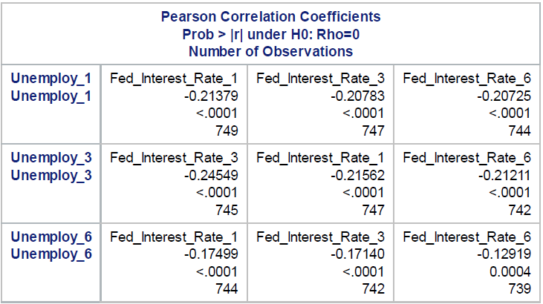
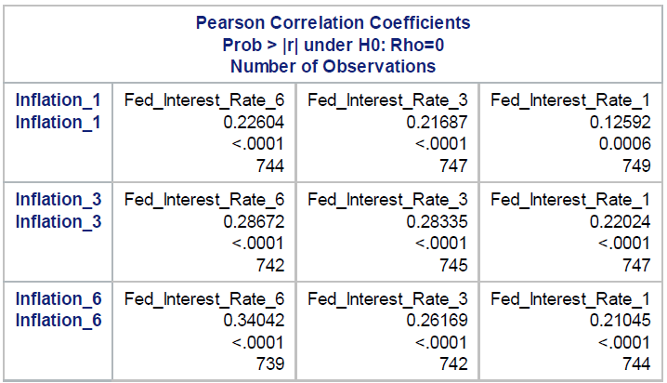
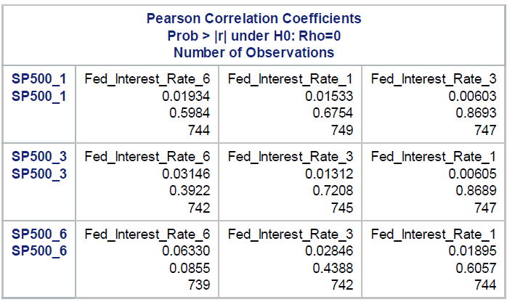
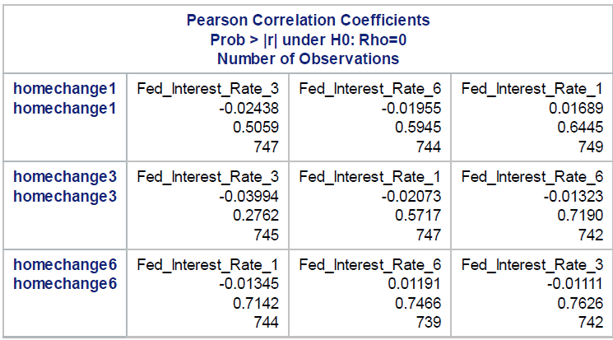
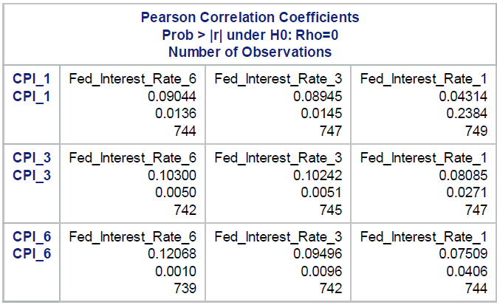
Pearson Correlation Coefficients for each Variable pair
Table 1a
Pearson Correlation for FFR vs Unemployment.
Table 1b
Pearson Correlation for FFR vs inflation.
Table 1c
Pearson Correlation for FFR vs S&P500.
Table 1d
Pearson Correlation for FFR vs Home Price.
Table 1e
Pearson Correlation for FFR vs CPI.
Notes:
Looking at the correlation results in more detail, Table 1a shows the results for unemployment – all combinations were significant, but 3 month change in FFR and unemployment change 3 months later had the highest correlation at -.245.
Table 1b shows the results for inflation – all but 6 month change in FFR and inflation change 6 months later had the highest correlation at .340.
Table 1c shows the results for S&P500 representing the stock market – all combinations were insignificant with P values higher than .05.
Table 1d shows the results for home prices – all combinations were insignificant with P values higher than .05.
Table 1e shows the results for CPI – not all combinations were significant, but the longer timeframes were significant with the highest being 6 month change in FFR and change in CPI 6 months later with a correlation of .121.

Slide 12
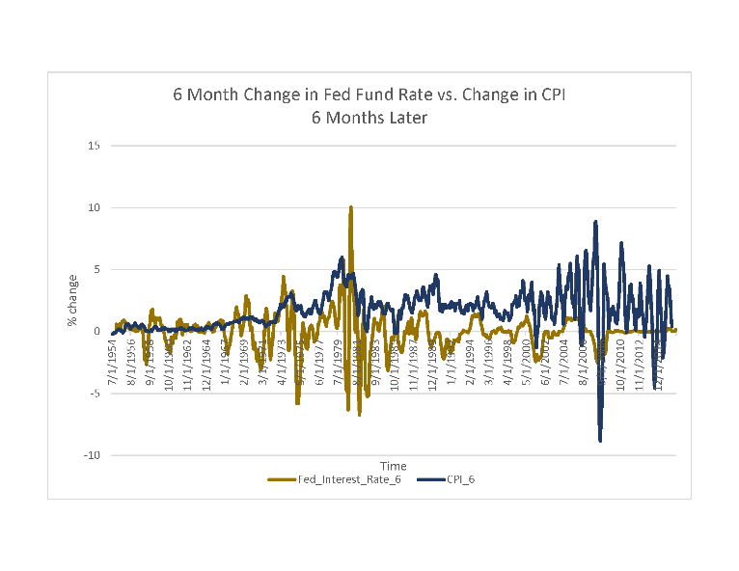
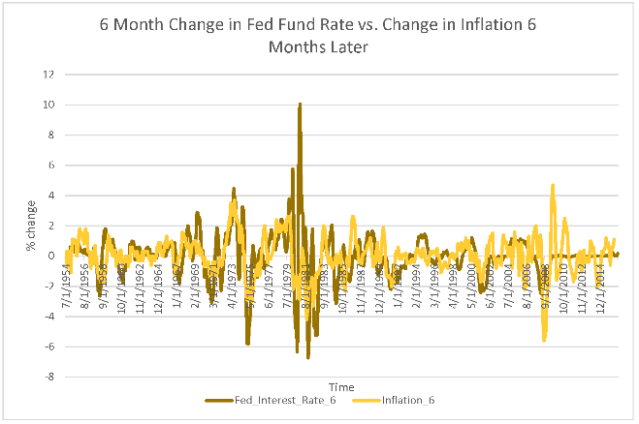
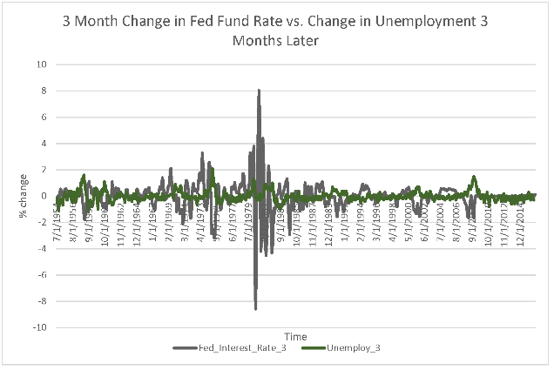
Changes in FFR compared to effects in CPI, Inflation, and Unemployment over Time
Fig. 1a
Changes in Fed Funds Rate and CPI over Time.
Fig. 1b
Changes in Fed Funds Rate and Inflation over Time.
Fig. 1c
Changes in Fed Funds Rate and Unemployment over Time.
Notes:
For the 3 variables with significant correlations, these visualizations of the strongest correlation timeframe pairs of each of the 3 show how closely they track over time. Not surprisingly, inflation had the highest correlation coefficient and tracks the closest to FFR while CPI had the weakest correlation of the 3 and tracks then least amount.

Slide 13
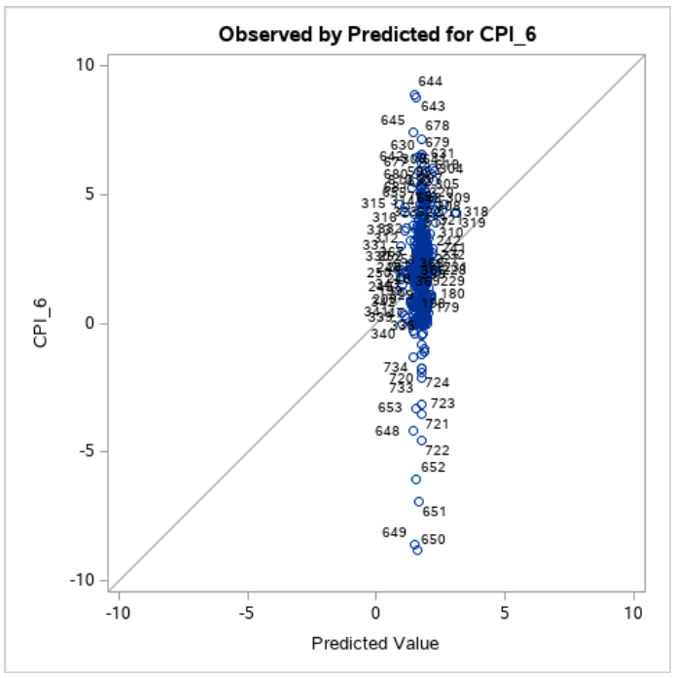
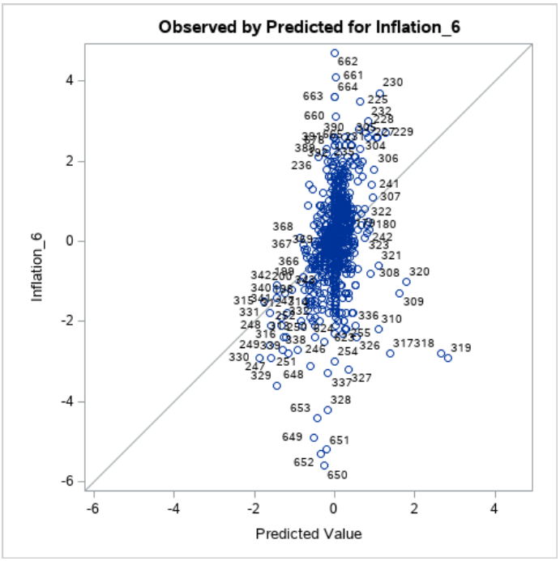
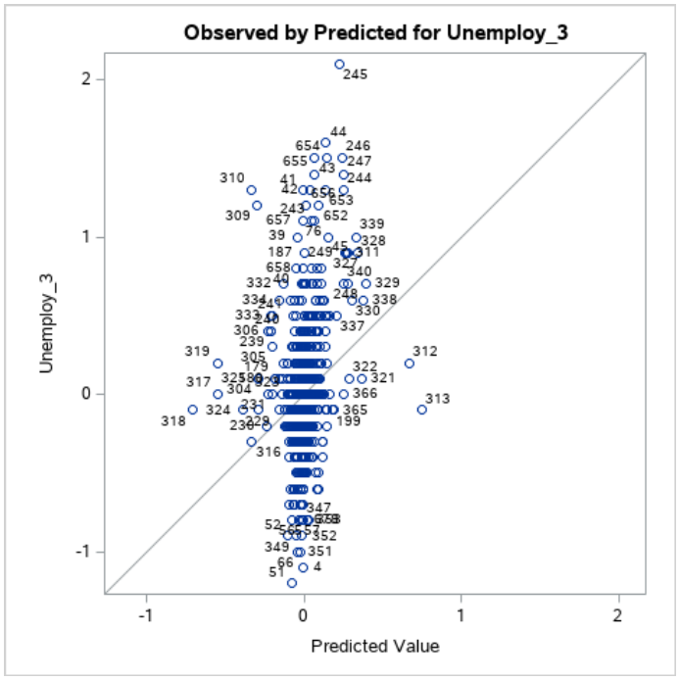
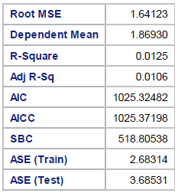
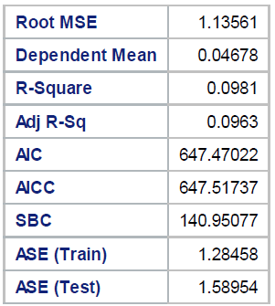
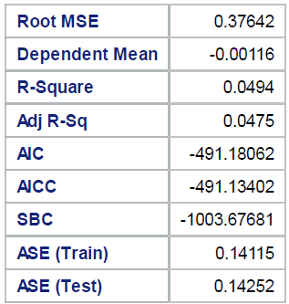
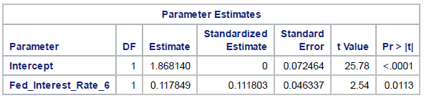
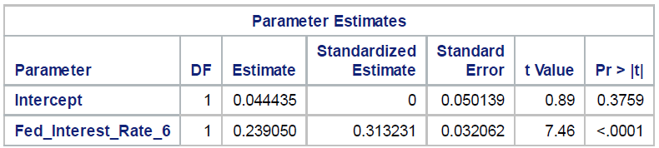
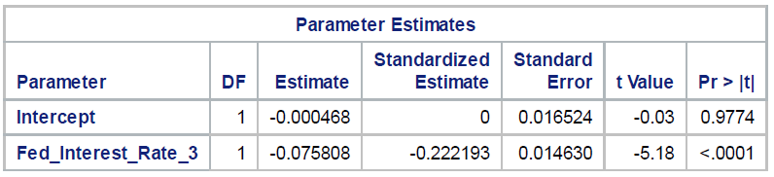
Predictive Linear Regression Models
FFR &CPI
FFR &Inflation
FFR &Unemployment
Figure 2a.
Results of Predictive Model of FFR v CPI
Figure 2b.
Results of Predictive Model of FFR v Inflation
Figure 2c.
Results of Predictive Model of FFR v Unemployment
None of these models create meaningful predictions as shown by the low R² values and uncorrelated plots
Notes:
The results of the linear regression model were not meaningful. While there was a tiny increase in the R squared values, looking at the distribution of predicted values from the model to actual values show that there is no real pattern or distinction. Most of the predicted values are similar regardless of the actual values. Therefor, these models are not useful as prediction tools. Additional research is needed to see if another model would be better.

Slide 14
Conclusion
There is no significant correlation between changes in monetary policy and changes in home prices or stock market performance.
There is significant correlation between changes in monetary policy and changes in inflation, unemployment and the consumer prices.
Changes in the FFR over 6 months give the best correlation for changes to inflation and the CPI.
The biggest impact is seen 6 months after the change in FFR.
Booth move in the same direction as FFR.
Changes in the FFR over 3 months give the best correlation for changes to unemployment.
The biggest impact to unemployment is seen 3 months after the change in FFR.
It reacts quicker to FRR than the other 2 conditions and decreases as FFR increases.
The timing and direction of impact of changes to inflation, unemployment and CPI can be predicted by changes in FFR.
There is not a reliable model that can be used to predict the amount of unemployment, inflation or CPI based on change in FFR.
Notes:
The results of the research find that there is no significant correlation between changes in monetary policy represented by changes in the Fed funds interest rate and changes in inflation adjusted home prices or inflation adjusted stock market performance.
However, there is significant correlation between changes in monetary policy represented by changes in Fed funds interest rate and changes in inflation, unemployment and the consumer prices, represented by the CPI.
Changes in the FFR over 6 months give the best correlation for changes to inflation and the CPI. The biggest impact to those economic conditions are seen 6 months after the change in FFR. Booth move in the same direction as FFR.
Changes in the FFR over 3 months give the best correlation for changes to unemployment. The biggest impact to unemployment is seen 3 months after the change in FFR. It reacts quicker to FRR than the other 2 conditions and decreases as FFR increases.
The result is the timing of when monetary policy changes will impact these conditions and the direction of that change can be predicted based on the data correlations.
There is not a reliable model that can be used to predict the amount of unemployment, inflation or CPI based on linear regression methods. The data is not correlated strong enough to provide meaningful predictions and additional research is needed.

Slide 15
Recommendations
Further study how monetary policy affects inflation, unemployment, and CPI using changes to money supply
Study if money supply has correlation with home prices or stock market performance, when interest rates did not.
Examine if money supply changes or other government actions can predict and quantify changes in economic conditions either alone or in combination with interest rates changes.
Study the impact of data from the COVID era on existing research.
Notes:
Because the research did not result in a model that can fully predict and quantify the economic outcomes, further study how monetary policy affects inflation, unemployment, and CPI is warranted. Using data that shows changes to money supply thru Quantitative Easing and stimulus correlate to the economic variables would add to the research.
Study if money supply has correlation with home prices or stock market performance, when interest rates did not would also advance the research.
Then an examination if money supply changes or other government actions can predict and quantify changes in economic conditions either alone or in combination with interest rates changes using multiple linear regression or other methods might be successful.
Additionally, study the impact of data from the COVID era on existing research may also add to the results of the research.

Slide 16
References
Al-Hadi, A., & Al-Abri, A. (2022). Firm-level trade credit responses to COVID-19-induced monetary and fiscal policies: International evidence. Research in International Business and Finance, 60. https://doi.org/10.1016/j.ribaf.2021.101568.
Bierens, H. J. (2000). Nonparametric nonlinear cotrending analysis, with an application to interest and inflation in the United States. Journal of Business & Economic Statistics, 18(3), 323-337. Retrieved from: https://csuglobal.idm.oclc.org/login?qurl=https%3A%2F%2Fwww.proquest.com%2Fscholarly-journals%2Fnonparametric-nonlinear- cotrending-analysis-with%2Fdocview%2F223218637%2Fse-2%3Faccountid%3D38569.
Cachanosky, N., Cutsinger, B. P., Hogan, T. L., Luther, W. J., & Salter, A. W. (2021). The Federal Reserve’s response to the COVID‐19 contraction: An initial appraisal. Southern Economic Journal, 87(4), 1152–1174. https://doi.org/10.1002/soej.12498.
Canova, F., Pappa, E., & Surico, P. (2011). Fiscal policy, pricing frictions and monetary accommodation. Economic Policy, 26(68), 555–598. https://doi.org/10.1111/j.1468-0327.2011.00272.x
Cochrane, J. H., & Piazzesi, M. (2002). The Fed and Interest Rates: A high-frequency identification. The American Economic Review, 92(2), 90–95.
Federal Reserve of St. Louis & US Bureau of Labor Statistics, (2016). Federal Reserve Interest Rates, 1954-Present. www.kaggle.com. Retrieved from: https://www.kaggle.com/datasets/federalreserve/interest-rates?resource=download.
Filardo, A., Hubert, P., & Rungcharoenkitkul, P. (2022). Monetary policy reaction function and the financial cycle. Journal of Banking and Finance, 142. https://doi.org/10.1016/j.jbankfin.2022.106536.
Gibson, W. E. (1972). Interest rates and inflationary expectations: new evidence. The American Economic Review, 62(5), 854–865.
Goodfriend, M. (2014). Lessons from a century of FED policy: Why monetary and credit policies need rules and boundaries. Journal of Economic Dynamics and Control, 49, 112–120. https://doi.org/10.1016/j.jedc.2014.09.005.
Notes:
Thank you for allowing me to present this research.

Slide 17
Heger, T., Aguilar-Trigueros, C. A., Bartram, I., Braga, R. R., Dietl, G. P., Enders, M., Gibson, D. J., Gómez-Aparicio, L., Gras, P., Jax, K., Lokatis, S., Lortie, C. J., Mupepele, A.-C., Schindler, S., Starrfelt, J., Synodinos, A. D., & Jeschke, J. M. (2021). The Hierarchy-of-Hypotheses Approach: A synthesis method for enhancing theory development in ecology and evolution. BioScience, 71(4), 337–349. https://doi.org/10.1093/biosci/biaa130.
Ireland, P.N. (2019). Monetary Policy Implementation: Making better and more consistent use of the Federal Reserve’s balance sheet. Journal of Applied Corporate Finance, 31(4), 68–76. https://doi.org/10.1111/jacf.12376.
Kariv, A. & Pollock, R., (2022). Standard and Poor's (S&P) 500 Index data including dividend, earnings and P/E ratio. www.datahub.io. Retrieved from: https://datahub.io/core/s-and-p-500#data.
Lacker, J. M. (2014). Fed Credit Policy: What is a Lender of Last Resort? Journal of Economic Dynamics and Control, 49, 135–138. https://doi.org/10.1016/j.jedc.2014.09.019.
PK, (2022). Historical US Home Prices: Monthly Median from 1953-2022. www.dqydj.com. Retrieved from: https://dqydj.com/historical-home- prices/.
Reis, R. (2009). Interpreting the unconventional U.S. monetary policy of 2007-09. Brookings Papers on Economic Activity, 119–182. https://doi.org/10.1353/eca.0.0068.
Shaw, D., & Satalkar, P. (2018). Researchers’ interpretations of research integrity: A qualitative study. Accountability in Research, 25(2), 79–93. https://doi.org/10.1080/08989621.2017.1413940.
Titman, S., & Warga, A. (1989). Stock returns as predictors of interest rates and inflation. The Journal of Financial and Quantitative Analysis, 24(1), 47–58. https://doi.org/10.2307/2330747.
US Department of Labor, (2022). CPI survey data. www.BLS.gov. Retrieved from: https://data.bls.gov/pdq/SurveyOutputServlet.
Wang, Y., & Mi, J. (2019). Applying statistical methods to library data. Serials Librarian, 76(1–4), 195–200. https://doi.org/10.1080/0361526X.2019.1590774.

